Slide 1
Startup in IT
UNIT 4

Slide 2
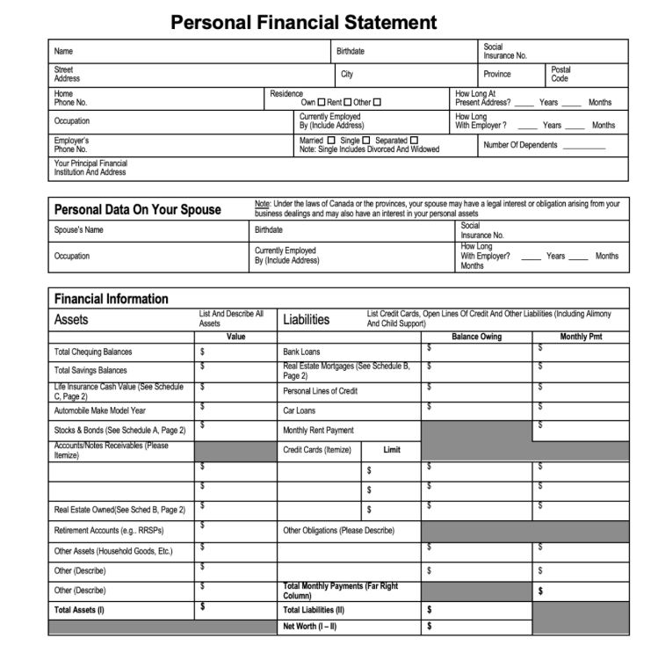
Personal Financial Statement
A personal financial statement is a document or spreadsheet outlining an individual's financial position at a given point in time.

Slide 3
Personal Financial Statement
Assets and liabilities outside business.
Personal net worth for each owner.
Key for business financing clarity.
Owners may use personal assets.
Shows available assets for business.
Investors and bankers require details.

Slide 4
Startup Expenses and Capitalization
Startup Expenses:
List of individual items required to start the business.
Includes every necessary resource for business launch.
Capitalization:
Total required investment to launch the business.
Represents the full cost of resources planned to be leveraged.

Slide 5
Entrepreneurs Should Clearly List:
Startup Expenses:
Every cost associated with getting the business operational.
Associated Costs:
Each item’s specific cost breakdown.
Unusual or Expensive Items:
Brief explanation of capital-intensive or expensive items.
Highlight any large upfront costs for critical items.

Slide 6
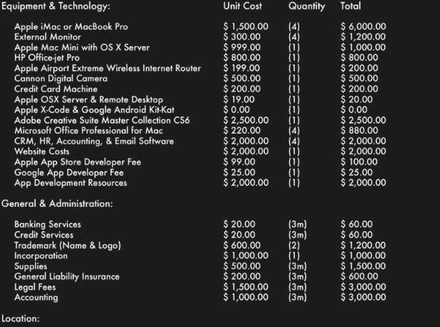
Startup Expenses and Capitalization

Slide 7
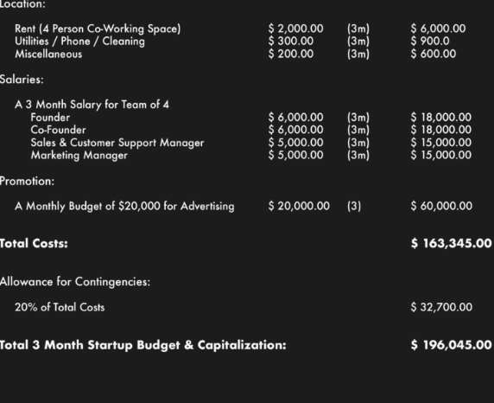
Startup Expenses and Capitalization

Slide 8
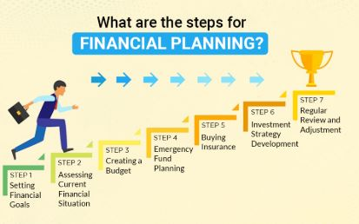
Financial Plan Financial planning is the task of
determining how a business will afford to achieve its strategic goals and objectives.

Slide 9
Financial Plan
12 Month Profit & Loss Statement:
Put numbers together for profitability.
Helps determine the path to success.
Three-Year Profit Projection (Optional):
Extends forecast beyond the first year.
Helps plan for long-term growth.
Projected Cash Flow:
Plan how much cash you need.
Includes preliminary expenses and reserves.

Slide 10
For Each Item:
Determine expected cash receipt timing.
Track when expenses need payments.
Opening Day Balance Sheet:
Fundamental financial report for businesses.
Essential for reporting and management.
Break-Even Analysis:
Dividing line between loss and profit.
Sales level needed to break even.

Slide 11
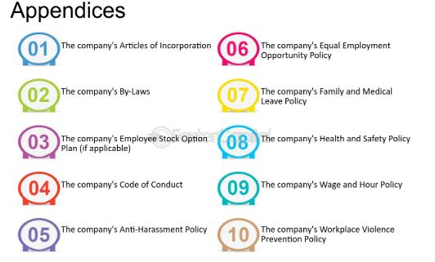
APPENDICES
The appendices contain letters and charts with important data that not only support the book's arguments, but also open new ways for future investigations.

Slide 12
APPENDICES
Include details and studies used in your business plan; for example:
Brochures and advertising materials
Industry studies
Blueprints and plans
Maps and photos of location
Magazine or other articles

Slide 13
Detailed lists of equipment owned or to be purchased
Copies of leases and contracts
Letters of support from future customers
Any other materials needed to support the assumptions in this plan
Market research studies
List of assets available as collateral for a loan

Slide 14
Refining the Plan
The generic business plan presented above should be modified to suit your specific type of business and the audience for which the plan is written

Slide 15
Refining the Plan
For Raising
Capital For Bankers
Amount of Loan:
Clearly state the loan amount requested.
How Funds Will Be Used:
Specify exactly how loan funds will be allocated.
What This Will Accomplish:
Explain how funds strengthen the business.
Requested Repayment Terms:
Outline the repayment schedule (years).
Collateral Offered:
List the collateral securing the loan.
Existing Liens Against Collateral:
Include any current liens on collateral.

Slide 16
Refining the Plan
For Investors
Funds Needed Short-Term:
capital for growth opportunities.
Funds Needed in 2-5 Years:
Scaling and market expansion goals.
How Funds Will Be Used:
Product development, marketing, operational expansion.
Estimated Return on Investment:
Projected high returns for investors.
Exit Strategy for Investors:
IPO, sale, or buyback options.
Investor Involvement and Ownership:
Equity offering, board or advisory role.

Slide 17
Refining the Plan
For Type of Business Manufacturing
Planned Production Levels:
Set targets for product output.
Production Cost Comparison:
Compare direct/indirect costs to industry averages.
Product Line Pricing:
Define prices for each product.
Gross Profit Margin:
Overall margin and per product line.
Production Capacity Limits:
Physical plant and equipment constraints.
Inventory Management & New Products:
Procedures and upcoming product developments.

Slide 18
Refining the Plan
Service Businesses
Key Competitive Factors:
Pricing, quality, and service flexibility.
Pricing Methods:
Cost-plus, market-based, or competitive pricing.
Production Management System:
Efficient processes, timely service delivery.
Quality Control Procedures:
Industry standards, consistent service quality.
Labor Productivity Measurement:
Output per worker, efficiency tracking.
Subcontracting, Credit, and Client Strategy:
Subcontracting, payments, and client retention.

Slide 19

STARTUP STORY FLIPKART
HISTORY
Back in 2007, when Flip kart was launched, Indian e- commerce industry was taking its beginner steps. The company is registered in Singapore, but their headquarters are in the city of Bangalore, India.

Slide 20
Founders
Sachin Bansal and Binny Bansal, who were working for Amazon.com had an idea to start an e-commerce
company in India. Both of them are alumni of IIT, Delhi and are native of Chandigarh, India. They left their jobs in Amazon to start their own business.

Slide 21

How it Started?
Flipkart began selling books to begin with. It soon expanded and began offering a wide variety of goods

Slide 22
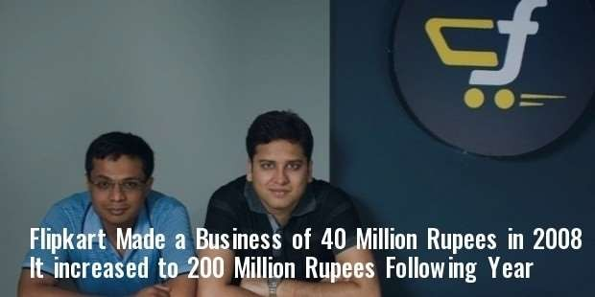
Funding History
This soon increased to 200 million Indian rupees the following year. Their last round of Fundraising had increased their value to $ 15 billion.

Slide 23
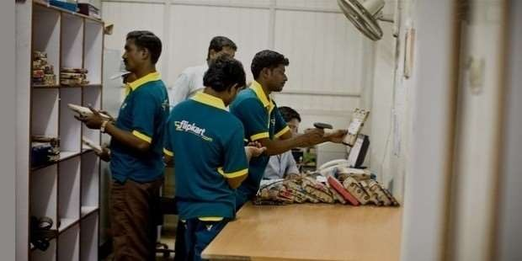
Evolution
Flipkart revolutionized online shopping in India by introducing Cash on Delivery (COD) and card payment on delivery, making it more accessible. COD became a standard feature across Indian e-commerce platforms after Flipkart's pioneering implementation.

Slide 24
Evolution
Flipkart solved delivery issues by creating its own system to ensure timely shipments. This helped them deliver orders quickly and reliably.

Slide 25

Acquisitions
Flipkart expanded its market presence by acquiring companies like Myntra and LetsBuy, transforming from a small book retailer to India’s largest e-commerce platform. Its journey has inspired startups and revolutionized the Indian e-commerce industry, breaking stereotypes along the way.

Slide 26

STARTUP STORY
Make My Trip
FOUNDER
Deep Kalra is the proud founder of Gurgaon based – MakeMyTrip.com.

Slide 27
STARTUP STORY
Make My Trip
FOUNDER
How did his journey begin?
Deep Kalra began his career after completing his Masters at IIM-A and worked at companies like GE Capital and ABN AMRO Bank. In 1995, he took a big risk by leaving his stable job to join AMF Bowling, an American company looking to set up bowling alleys and billiard halls in India.

Slide 28
STARTUP STORY
Make My Trip
FOUNDER
How did his journey begin?
Deep Kalra worked hard and managed to open over 200 bowling lanes, mostly in small centers. However, the venture wasn’t his own, and he had a distant boss in America who didn’t provide the proper guidance or support.

Slide 29
STARTUP STORY
Make My Trip
FOUNDER
How did his journey begin? Evidently, for obvious reasons this did not appeal to him and he also realized that they were all not worth his talent. He needed something more to showcase the same!

Slide 30
STARTUP STORY
Make My Trip
FOUNDER
How did his journey begin?
Deep Kalra noticed the growth of the internet and quit his job to simplify the messy online travel booking industry. He founded MakeMyTrip, transforming travel bookings and quickly making it one of India’s leading travel platforms.

Slide 31
STARTUP STORY
Achievements
Chairperson of the NASSCOM Internet Working Group Member of the Executive Council of NASSCOM
Member of CII’s Tourism sub-committee
Awarded as the “Best Travel Portal India” by World Travel Awards (2014, 2013)
Awarded as the “E-tailer of the Year” by ET Retail Awards (2014, 2013)
Awarded as the “Best Online Travel Service Firm” by Times Travel Honours (2011)
Listed as “Ten Best Companies to Work For in India” by Great Place to Work Institute (2013, 2012, 2011, 2010)

Slide 32
Thank you

